Slide 1
ASSET QUALITY REVIEW(AQR) FOR ABC BANK
POWER BI PROJECT PRESENTATION
By
Akash narang

Slide 2
introduction
Objective of AQR
Assess the quality of assets held by bank
Identify potential risks and areas for improvement
Importance of AQR for Banks
Regulatory Compliance
Risk Management

Slide 3
definition
An Asset Quality Review (AQR) is a systematic assessment conducted by banks or regulatory authorities to evaluate the quality of a bank's assets, particularly its loan portfolio. The primary objectives of an AQR include:
Identifying Non-Performing Assets
Assessing Credit Risk
Evaluating Loan Loss Provisions
Compliance with Regulatory Standards
Improving Risk Management
Overall, the AQR aims to provide a clear picture of a bank's financial health and stability by scrutinizing the quality of its assets and ensuring sound risk management practices.

Slide 4
Important terms in aqr
Asset Quality: Refers to the creditworthiness of a bank's assets, primarily loans and investments, indicating their likelihood of default.
Non-Performing Loans (NPLs): Loans on which the borrower is not making interest payments or repaying any principal.
NPL Ratio: The ratio of non-performing loans to total loans, used to assess the quality of a bank's loan portfolio.
Loan Loss Provisions: Funds set aside by banks to cover potential losses from bad loans, reflecting the bank’s expectations of future loan defaults.
Coverage Ratio: A metric that compares the allowance for loan losses to the total non-performing loans, indicating how well a bank can absorb potential losses.
Standard Loans: Loans that are currently being repaid as scheduled, indicating lower credit risk.
Classified Assets: Assets that have been categorized based on their risk level, including substandard, doubtful, and loss classifications.
Regulatory Compliance: Adherence to laws and regulations governing financial institutions, including capital adequacy and asset quality standards.
Credit Risk: The risk of loss arising from a borrower’s inability to repay a loan or meet contractual obligations.

Slide 5
Data sources and preparation
Data Sources
External sources (market data)
Data Preparation Steps
Data cleaning, transformation, and normalization
Ensuring data accuracy and completeness

Slide 6
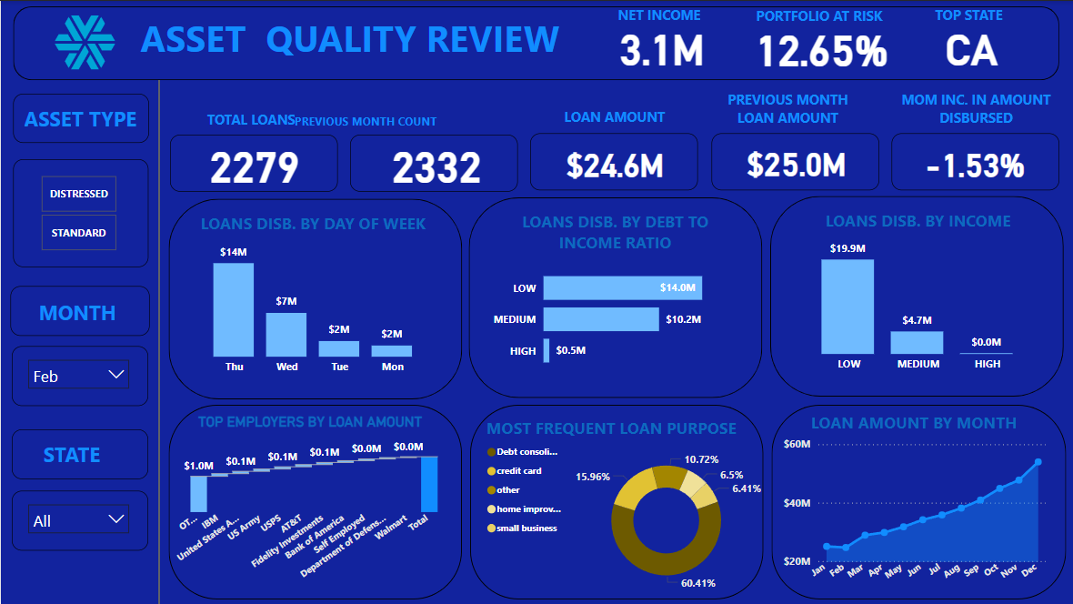
Power BI report Overview

Slide 7
Key Features of power bi report
Interactive filters
Interactive Filters like Asset Type, Month and Geographical location have been used to clearly explain the key KPI’s.
Key performance indicators (KPIs)
KPI’s such as Total No. of Loans, Total Loan Amount Disbursed, Previous Month Data, Month on Month Increase, Net Income, Portfolio at Risk, Top State have been displayed prominently.

Slide 8
KEY INSIGHTS
Overall Portfolio at Risk stands at 15.04%. It has increased from 14% last year to 15.04% this year.
There are 3583 distressed loans that have been sanctioned to employees of 3583 employers. It means that only one loan has been given to employees of these employer and that one loan has become distressed. This seems like an anomaly.
On analysing distressed loans, it was found that the loans that were disbursed on last day of the week form 21% of total distressed loans.
13% of distressed loans have been disbursed in the month of December.
The purpose of loan is Debt Consolidation in 60% of total distressed loans disbursed.

Slide 9
Recommendations
Strategies for Improvement
Strengthening credit underwriting processes.
Enhancing monitoring and reporting systems.
Proactive Risk Management
Regular reviews of asset quality.
Engaging with borrowers at risk.

Slide 10
THANK
YOU

